Slide 1

Group 7 Dazed & Confusion MATRIX: FINAL PRESENTATION
Andrea Irina Yzeiri | 260991862
Bogdan Tanasie | 260747949
Marek Krowicki | 260175752
Sam Greene | 260722742
Tiancheng Zhang | 260974250

Slide 2

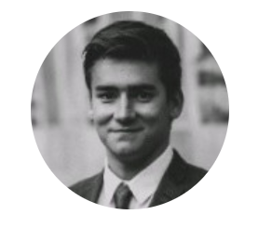



THE TEAM
Andrea Yzeiri (https://github.com/Andrea-Yzeiri)
Project Manager/Data Scientist
“I can definitely manage this project and keep us on
track.”
Bogdan Tanasie (https://github.com/bogdan-tanasie)
Software Developer/Architect
“Crime datasets look like fun.”
Marek Krowicki (https://github.com/Marek7869)
Data Analyst
“I consider myself a Data Massager.”
Sam Greene (https://github.com/samegreene55)
Business Analyst
“As long as I don’t have to do the same work as a capstone strategist.”
Tiancheng Zhang (https://github.com/tipsytc)
Data Analyst
“Can I be the sommelier to the Assistant to the Data
Analyst?”

Slide 3

AGENDA

Slide 4
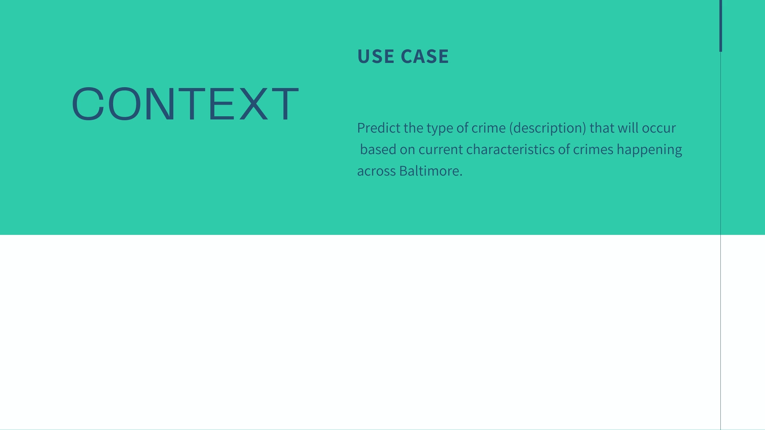





The Minority Report “Precrime” Prediction
Police response will be different based on the type of crime
Helps in preparation, urgency, level of response
Crime deterrent: increases likelihood of capture
Inherently unpredictable: red ball is crime of passion

Slide 5
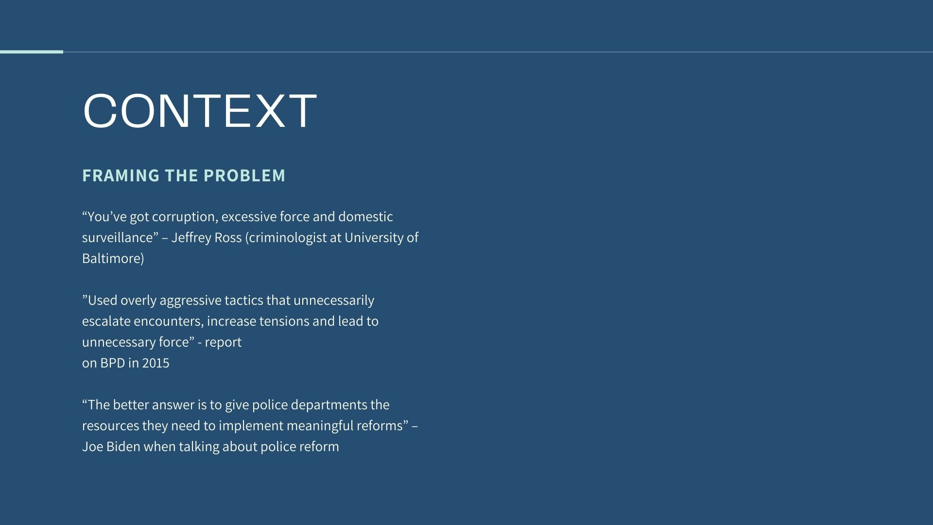

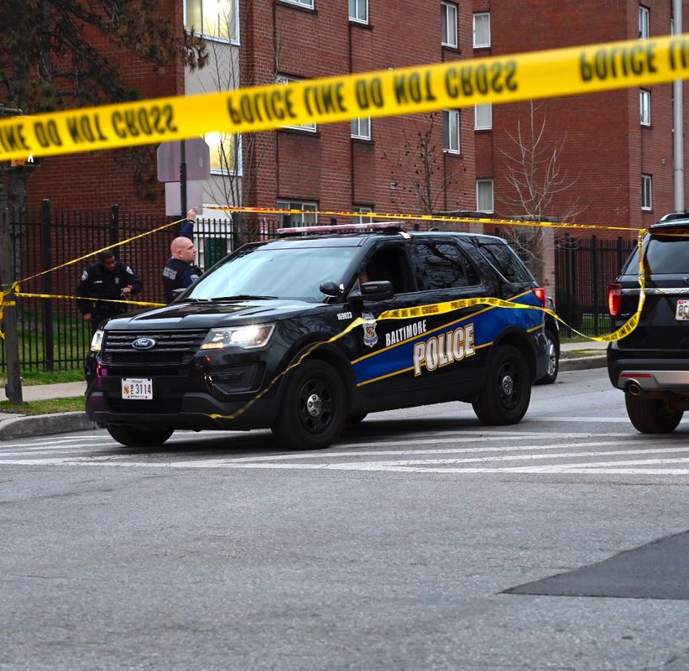

Slide 6
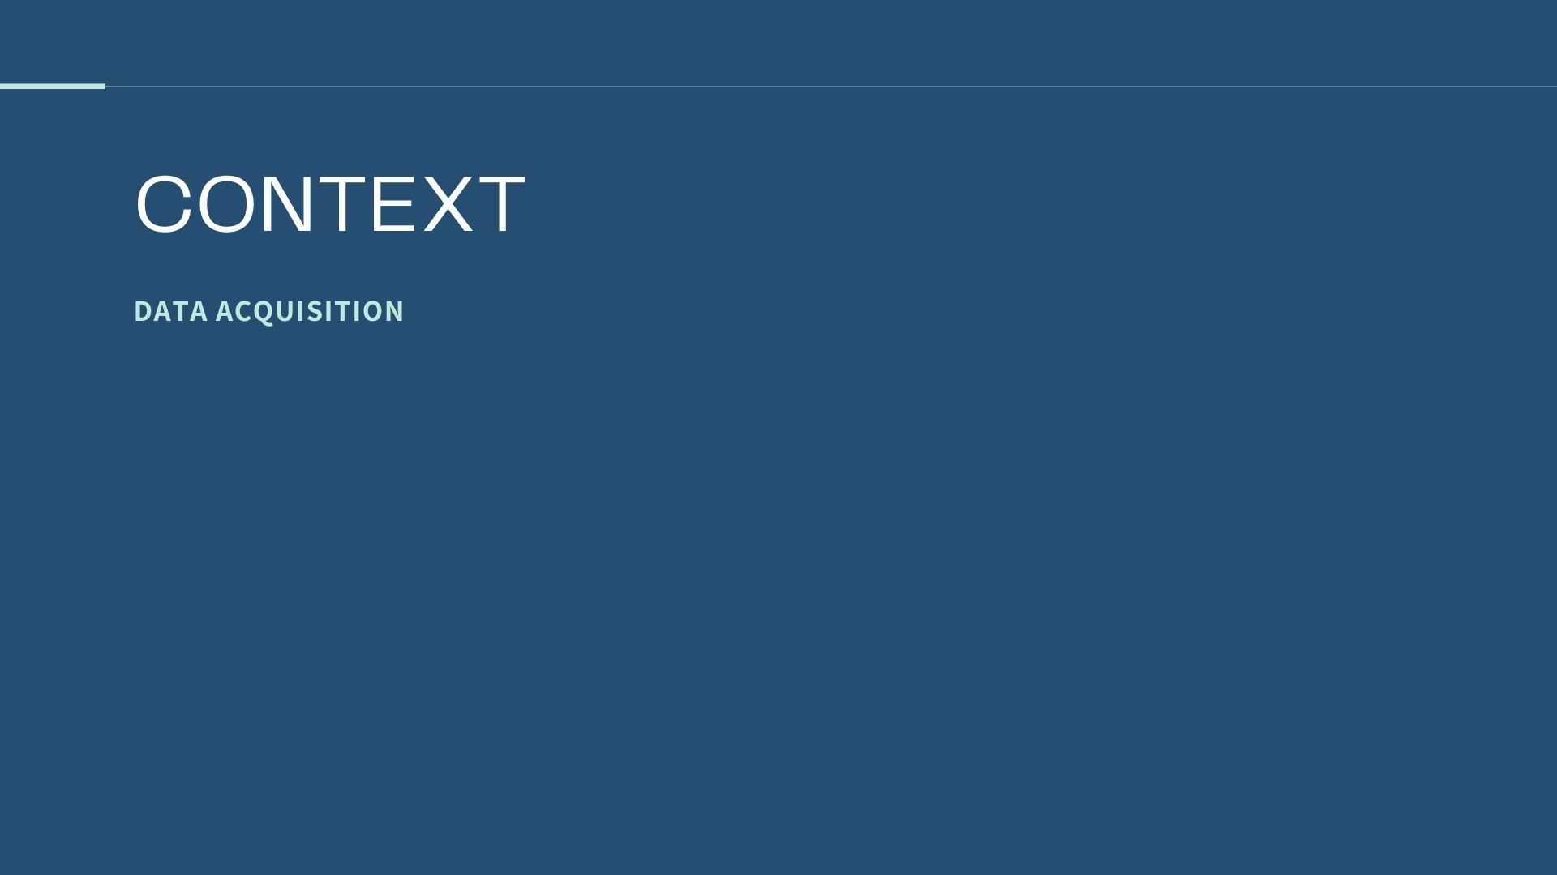


Ideal Data
Complete data on crimes in Baltimore
Current, data on crime sprees (arsonery, sexual assault, robberies, etc)
Criminal Records data
Last 3 years <
Practical Building
Open source data on crimes in Baltimore
Last 2 years
Limited in variables
FBI database
Police force databases in Baltimore
Prisons *Dependent*
Kaggle
No legal obligations
No sensitive information
High legal obligations
High clearance/authorization
Protect sensitive information on criminals
Used to test our hypothesis and begin a research cycle!

Slide 7
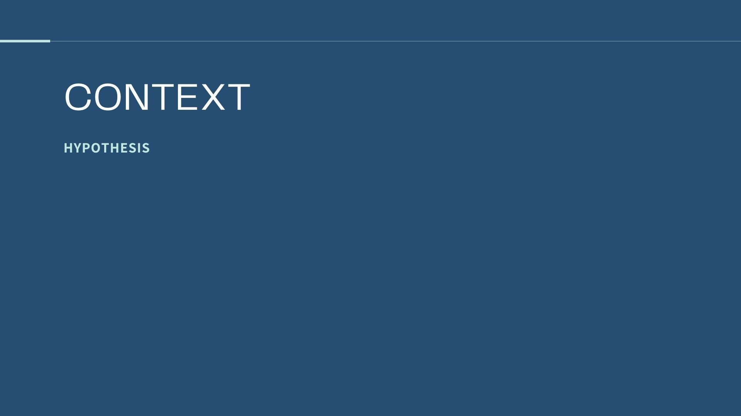
HYPOTHESIS
HYPOTHESIS
Logical
Empirical
LightGBM provides the best balance of precision and recall for predicting the type of crime to occur next in Baltimore.
An accurate predictive tool will improve the Baltimore’s police force’s KPI’s.
Trials (Testing)
Outcome
Advantages

Slide 8







Sampling Bias
Current sample is not as representative of the population. No crime.
Economic crashes or social changes outside of the norm.
History
Crime rates can improve over time.
Maturation

Slide 9

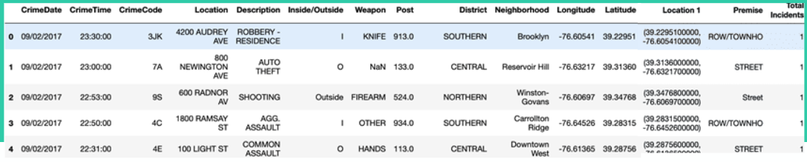

Source: https://data.baltimorecity.gov/
Crime Attributes
Pre-Processing and Feature Engineer
Categorical
CrimeCode
Location
Description (Y)
Inside/Outside
Weapon
Timestamp
CrimeDate and CrimeTime
Post
District
Neighborhood
Premise
Numerical
Longitude and Latitude
Total Incidents
➔Kept for visualization
➔Clean and Regroup categorical variables
➔Drop variables with repeated info
➔Geographical kept at neighborhood level
➔Extract season, month and hour of day

Slide 10
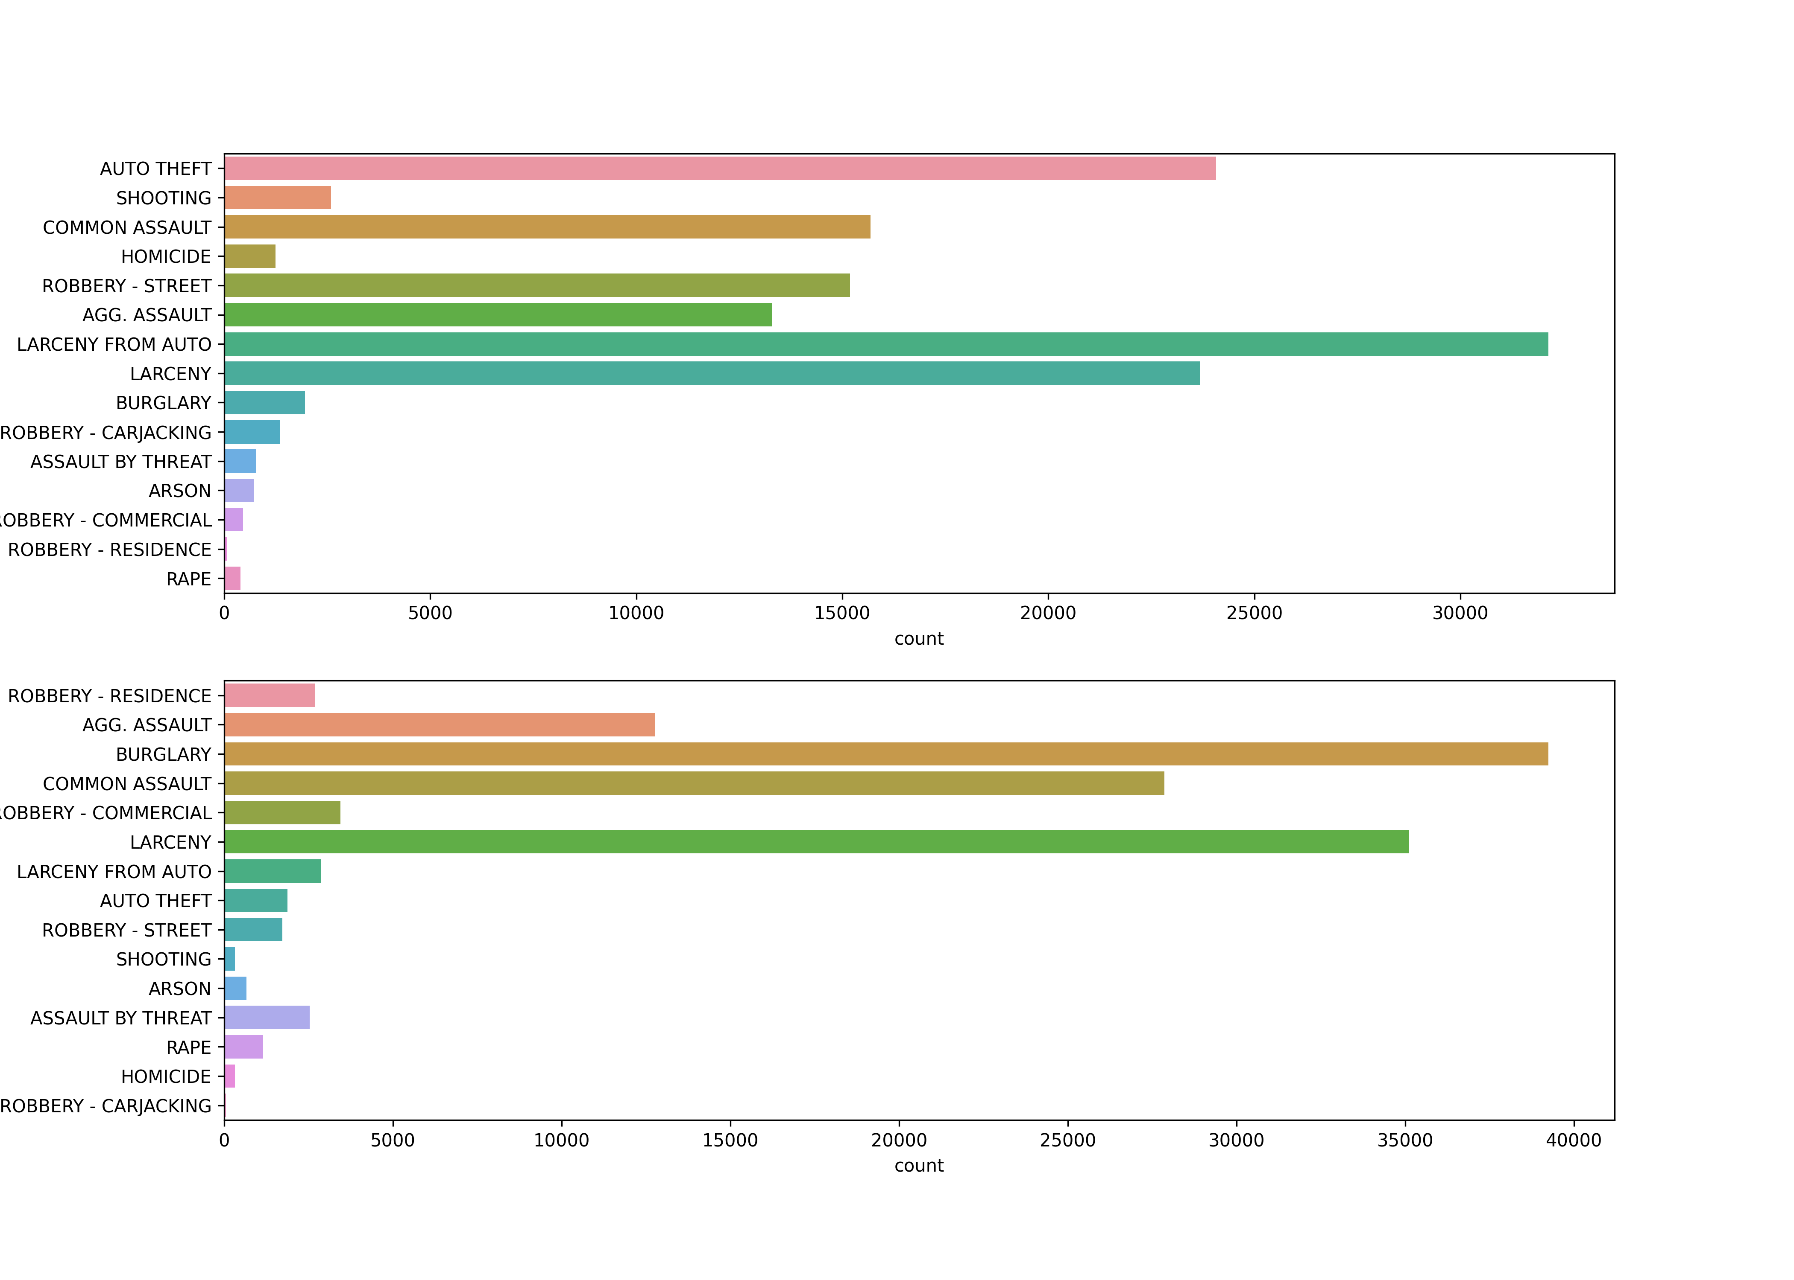

Crime Description
VS
Inside/Outside
Notes:
We do notice correlations between crime descriptions and Inside/Outside such as AUTO-THEFT and LANCERY FROM AUTO are mostly happened OUTSIDE. But overall it‘s still a valid and important predictor.

Slide 11



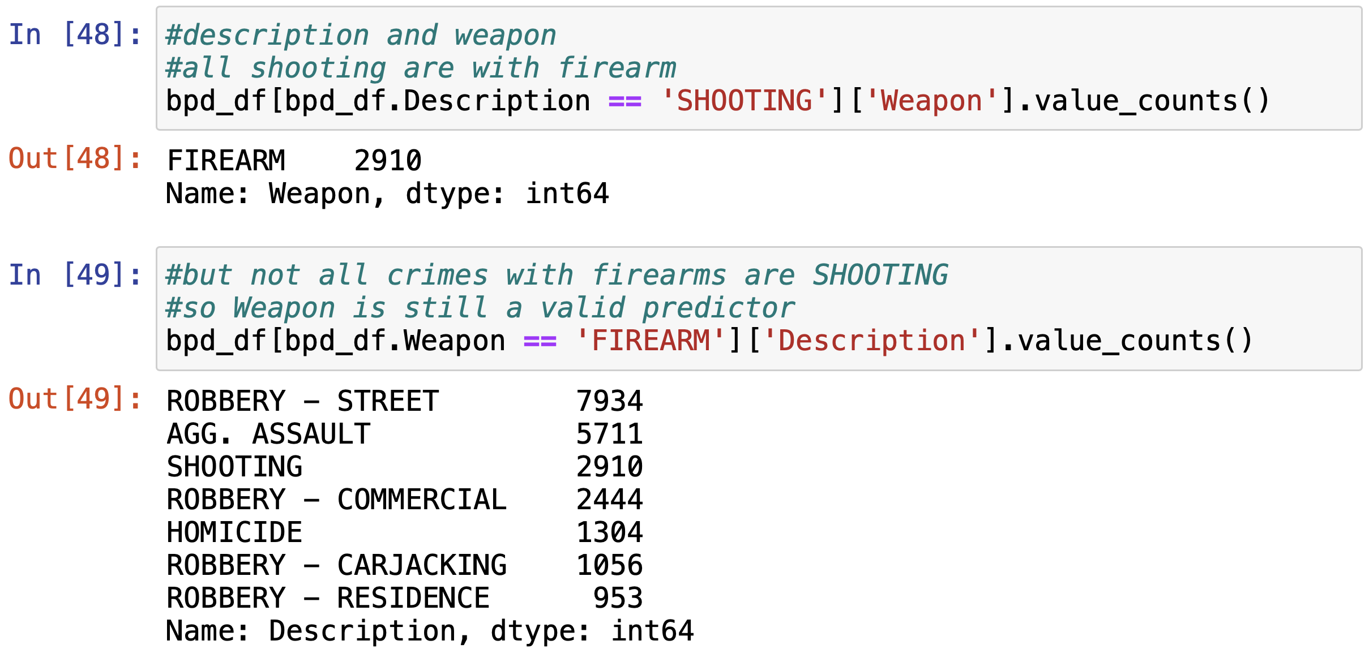
Crime Description
VS
Weapon
Notes:
Similarly, all crimes with shooting are done with firearms but not all crimes with firearms are labelled as shooting.

Slide 12
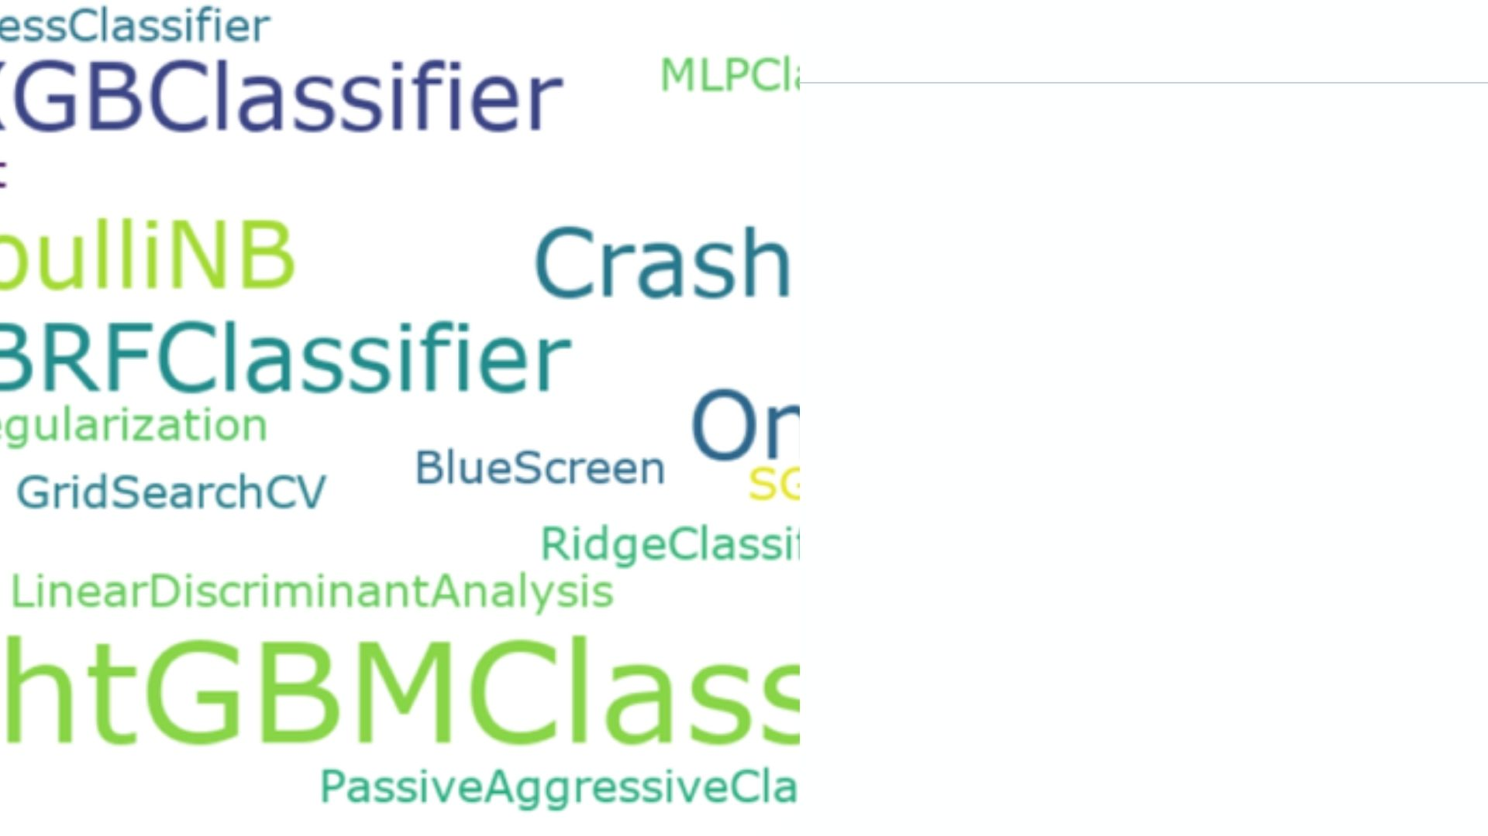
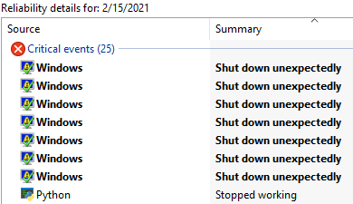
Multiclass Classification Algorithms
Trial and Error
➔ Trial and Pray No Blue Screen

Slide 13

Train set: 2012/01/01 – 2017/09/02 (263,121 rows)
Test set: 2017/09/03 – 2018/12/31 (65,669)
Multi-class Classification
Target Variable: Description
15 Classes: Robbery, Homicide, Shooting, etc
Predictors
Inside/Outside
Weapon
Neighborhood
Premise
Month
Hour
One-hot encoding
One-hot
encoding
Label encoding
10 Columns
441 Columns

Slide 14


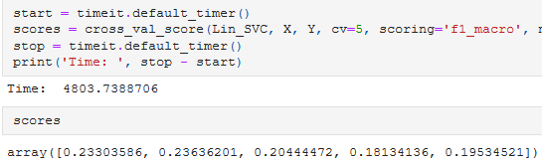
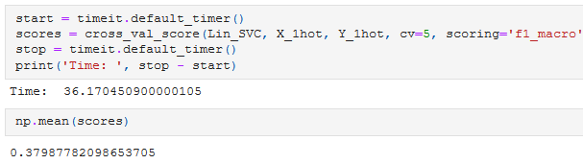
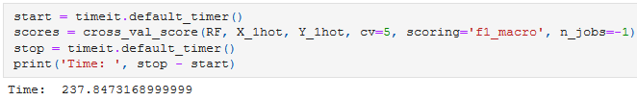
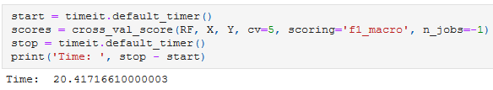
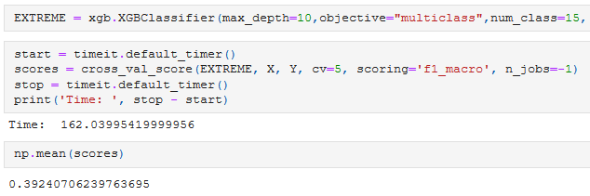
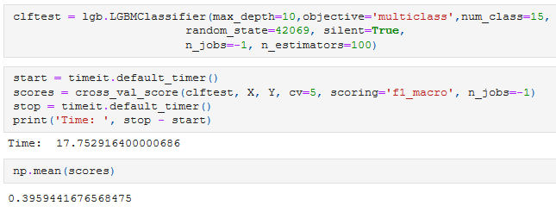
MODELLING
TESTING DIFFERENT MODELS
BernoulliNB
Linear SVC
Some models run much faster and give better results if all data is 1-hotted
BETTER EFFICIENCY
Random Forest
Random Forest – label encoding
Not the case with tree-based models such as Random Forest
XGBoost
LightGBM
Most
promising candidates

Slide 15




MODELLING
RESULTS OF FINAL MODELS
LightGBM
BernoulliNB
5-fold CV F1 score: 0.39988
5-fold CV F1 score: 0.41302!
0.40402
0.26948
Accuracy
Accuracy
0.40402
0.26948
Recall
Recall
0.51259
0.39516
Precision
Precision
0.43948
0.29698
F1 statistic
F1 statistic

Slide 16
MODELLING: FINAL MODEL
LightGBM
0.40402
Accuracy
0.40402
Recall
0.51259
Precision
0.43948
F1 statistic

Slide 17
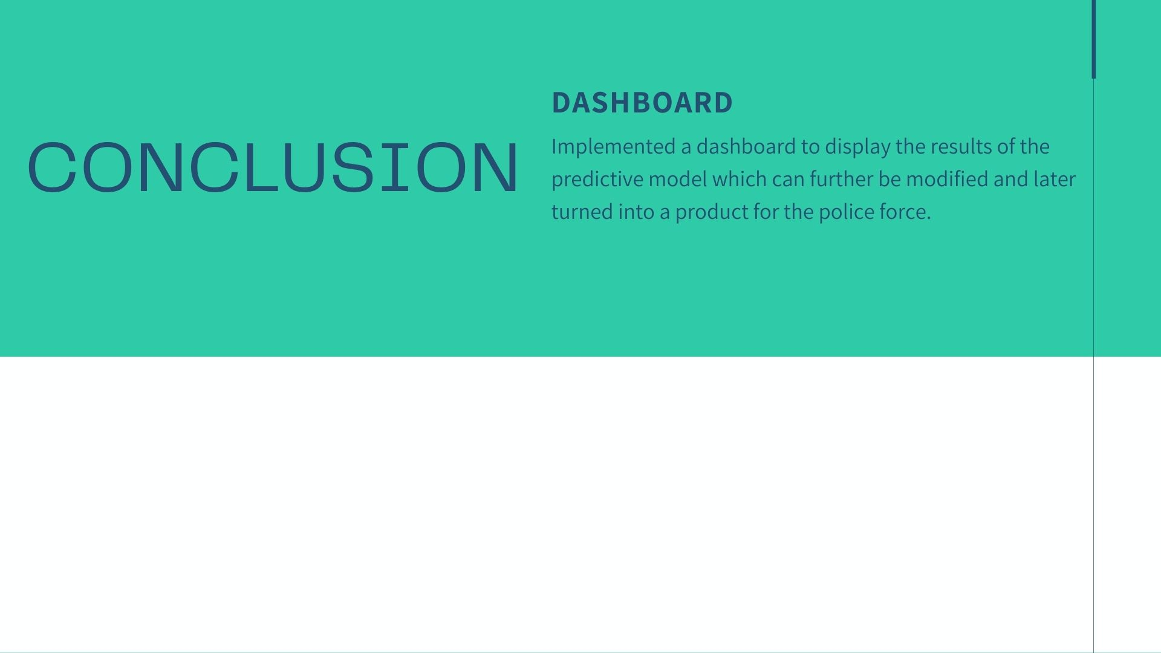

Pros
Cons
Great monitoring tool
Fast setup
Broad integration
Easy to use to use interface for both users/admins
Early development => limited features
Initial performance issues
Difficulty setting up unit tests

Slide 18
LIVE DEMO
LIVE DEMO

Slide 19



LAUNCHING
App ready to go to production
Currently pending approval on Streamlit
Minor work to be done in automation
MONITORING
One of the main goals of the project
Potential to improve alerts and use email
MAINTENANCE
Working on organizing the repository
Use of documentation

Slide 20

Making predictions for just over a year into the future as test set
Crime has evolved
New weapon included in data: “Fire” for arson cases
New neighborhoods, either new or did not report crime previously
New premises for crimes
Data inconsistency
39 missing neighborhoods: either renamed or crime did not occur in test period
90 missing premises: most likely due to changes in data format
1 hot encoding impractical: each missing class = 1 missing feature. “Best” NB model performs terribly: 39% difference in F1 score compared to LightGBM with label encoded data
Test set more than halved in size (22,729 remaining rows): 65% of new crimes cannot be predicted based on all features of model trained on past data
LESSONS LEARNED

Slide 21
Algorithmic Bias
Models built strictly on past data can be discriminatory
Control for this in future model training
Model interpretation
Assess interpretation vs accuracy tradeoff between models
Officers should know the reasons behind the predictions
Future Work
Source: https://www.tandfonline.com/doi/full/10.1080/01900692.2019.1575664

Slide 22

QUESTION PERIOD

Slide 23
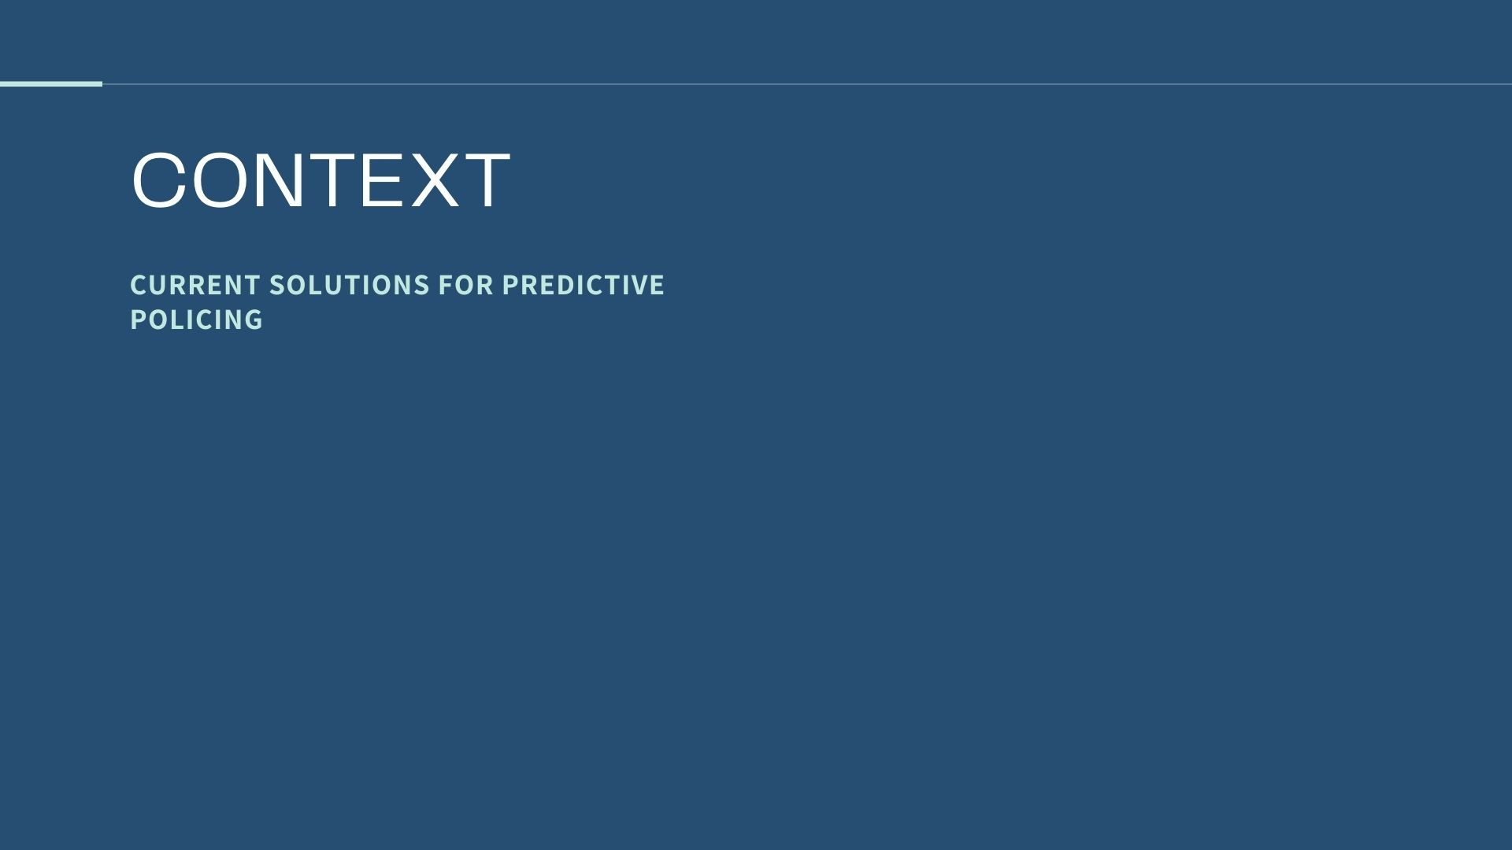
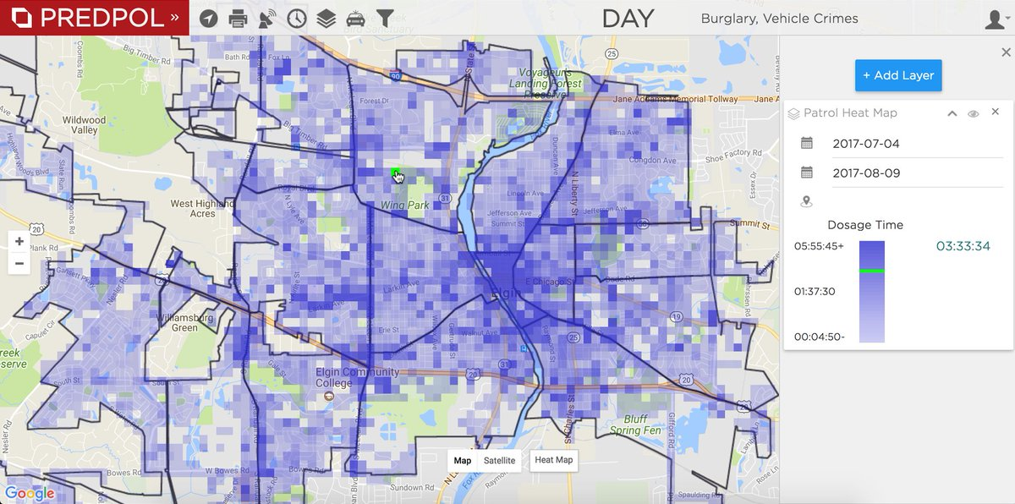
Additional Slides
These systems predict when and where a crime will occur based on patterns.
Current systems:
Crime Anticipation System (CAS) – Amsterdam
Our solution aims to improve police effectiveness by showing an officer what type of crime they are about to encounter, using situation specific variables.
PreCobs – Germany
PredPol – Los Angeles
Hunchlab – Philadelphia

Slide 24
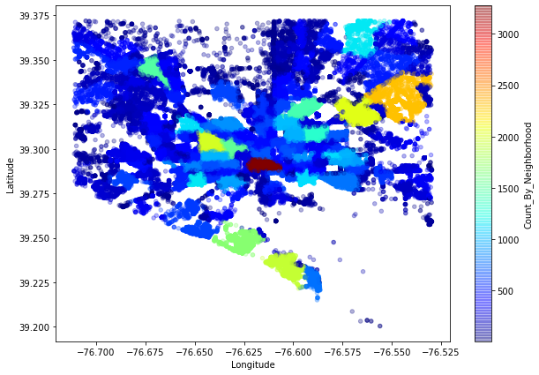

Crime Concentration By Neighborhood

